Slide 1
THE FACULTY OF ECONOMIC SCIENCES OF WARSAW UNIVERSITY
Ancient sites and states of the Azerbaijani region
Seljuk Invasion
Author: Elgun Ismayilov

Slide 2
Introduction
The Seljuk Empire, or the Great Seljuk Empire, was a high medieval, culturally Turco-Persian, Sunni Muslim empire, established and ruled by the Qïnïq branch of Oghuz Turks.The empire spanned a total area of 3.9 million square kilometres (1.5 million square miles) from Anatolia and the Levant in the west to the Hindu Kush in the east, and from Central Asia in the north to the Persian Gulf in the south, and it spanned the time period 1037 - 1308, though Seljuk rule beyond the Anatolian peninsula ended in 1194.
The Seljuk Empire was founded in 1037 by Tughril (990–1063) and his brother Chaghri (989–1060), both of whom co-ruled over its territories; there are indications that the Seljuk leadership otherwise functioned as a triumvirate and thus included Musa Yabghu, the uncle of the aforementioned two.

Slide 3
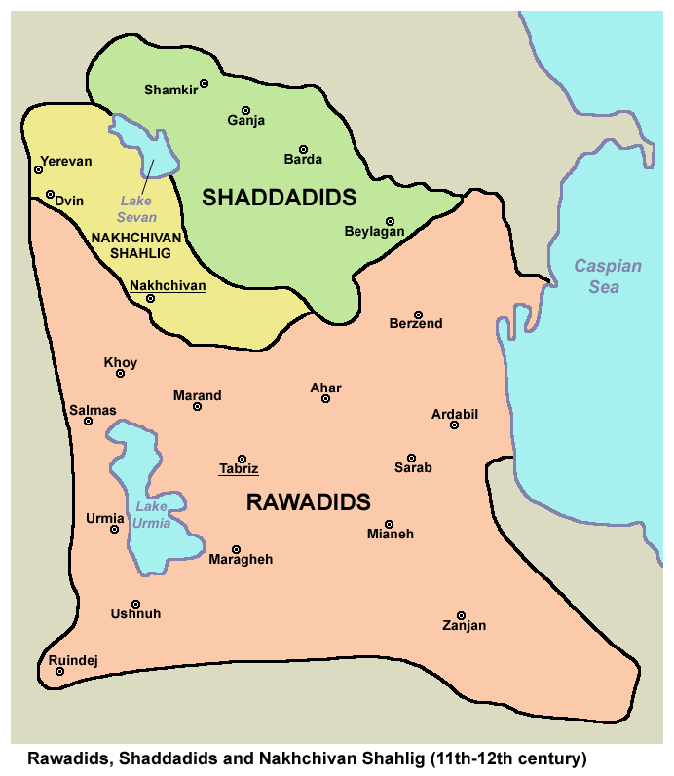
Political situation in Azerbaijan before the invasion
The Shaddadids were a Muslim dynasty that ruled over various territories of Armenia and Azerbaijan from 951 to 1199. Their main base was established in Dvin, which is now part of present-day Armenia.
During the period of weakness of the Salarid rule, Abu'l-Hajja, the ruler of Tabriz, Maragha, and Ahvaz, ousted Ibrahim ibn Merzban, the last ruler of the Salarid state (962–981), from the throne in 981 and established the foundation of the Rawadid state.
The Shirvanshahs' state existed from 861 to 1538 mainly in the southeastern Caucasus, particularly in present-day Azerbaijan Republic and partially in present-day Dagestan. It was a state that once existed and later became Azerbaijani.

Slide 4
The Seljuk invasion of Azerbaijan took place in the mid-11th century
The Seljuk invasion of Azerbaijan took place in the mid-11th century, during the reign of Sultan Alp Arslan and Sultan Tughril Beg.
In 1054–1055, the Seljuk army, led by Sultan Tughril Beg, marched into Azerbaijan and approached the city of Tabriz. Recognizing his inability to withstand the might of the Seljuks, the Rawadid ruler, Vahsudan, acknowledged Tughril Beg's authority, ordered sermons to be delivered in his name, and presented the sultan with valuable gifts. Consequently, the Rawadid rulers also accepted Seljuk suzerainty.

Slide 5
Shirvan’s invasion
In the year 1066, the Oghuz Turks invaded Shirvan for the first time, plundering their settlements and seizing a significant amount of booty, including people, goods, and property. To compel the Oghuz to leave Shirvan, Shirvanshah I Fariburz ibn Salar had to pay a substantial compensation.
In late 1067, during the reign of Seljuk Sultan Alp Arslan, vassal dependency was established. Sultan Alp Arslan entered Arran, solidifying Seljuk control over the region.

Slide 6
Invasion of Shaddad
In 1073-1074, the ruler of Shaddad, Fazlun, son of II Fazl, opposed his father and removed him from power, taking control of the country. However, in 1075, a large army led by Savtekin, an emir of Seljuk Sultan Malik Shah, was sent to Arran. Despite the resistance shown, Fazlun ultimately had to surrender the administration of Arran to Savtekin.

Slide 7
Decline of Seljuk Power
By the late 12th century, the Seljuk Empire began to fragment and decline due to internal strife and external pressures from the Crusaders, Mongols, and other emerging powers. In Azerbaijan, the decline of Seljuk authority paved the way for the rise of local dynasties and subsequent invasions by the Mongols in the early 13th century.

Slide 8
Seljuk invasion impact on Azerbaijan
The Seljuk rule had profound impacts on Azerbaijan:
Political Structure:
The Seljuks introduced a feudal system and divided the region into various emirates and fiefdoms. Local rulers were often appointed as vassals of the Seljuk sultans.
Cultural and Religious Influence:
The Seljuks were instrumental in promoting Islam and Turkish culture in Azerbaijan. The spread of Sunni Islam was particularly significant during their rule.
Economic Development:
The stability provided by the Seljuk rule facilitated trade and economic development. Azerbaijan, with its strategic location along the Silk Road, benefited from increased trade.
Architecture and Urbanization:
The Seljuks contributed to the architectural heritage of Azerbaijan, building fortresses, mosques, and madrasas. Cities such as Tabriz and Baku saw significant growth and development during this period.
Integration into the Islamic World:
Under Seljuk rule, Azerbaijan became more integrated into the broader Islamic world, contributing to its cultural and scientific advancements.

Slide 9
Legacy os Seljuk
The Seljuk invasion and subsequent rule left an enduring legacy in Azerbaijan, shaping its political, cultural, and religious landscape. The Turkish influence introduced by the Seljuks continued to play a significant role in the region's history, laying the groundwork for future Turkish states and empires in the area.
Overall, the Seljuk period was a transformative era for Azerbaijan, integrating it more closely into the Islamic and Turkic worlds and setting the stage for its future development.

Slide 10
Bibliography
Wikipedia.com
Revvadiler devleti
Şirvanşahlar dövrü
Şeddadiler devleti

